Slide 1
Student Name: k jaya raju Final Project: key logger and security

Slide 2

Keylogger and security
Exploring the potential risks and countermeasures of keylogging technology to enhance cybersecurity awareness.

Slide 3
Agenda
Overview
This presentation will provide an in-depth look at the risks and mitigation strategies for keyloggers, a critical security vulnerability.
Key Topics
What are keyloggers and how do they work?
Potential impacts of keylogger attacks
Best practices for keylogger detection and prevention
Case studies of real-world keylogger incidents
Q&A and audience discussion

Slide 4
Problem Statement
Keylogger Threats
Keyloggers pose a serious security risk by secretly recording a user's keyboard input, potentially exposing sensitive information like passwords and financial data.
Lack of User Awareness
Many users are unaware of keylogger threats or lack the knowledge to effectively safeguard their devices and online activities.
Inadequate Security Measures
Existing security solutions may not provide comprehensive protection against sophisticated keylogger attacks, leaving users vulnerable.

Slide 5
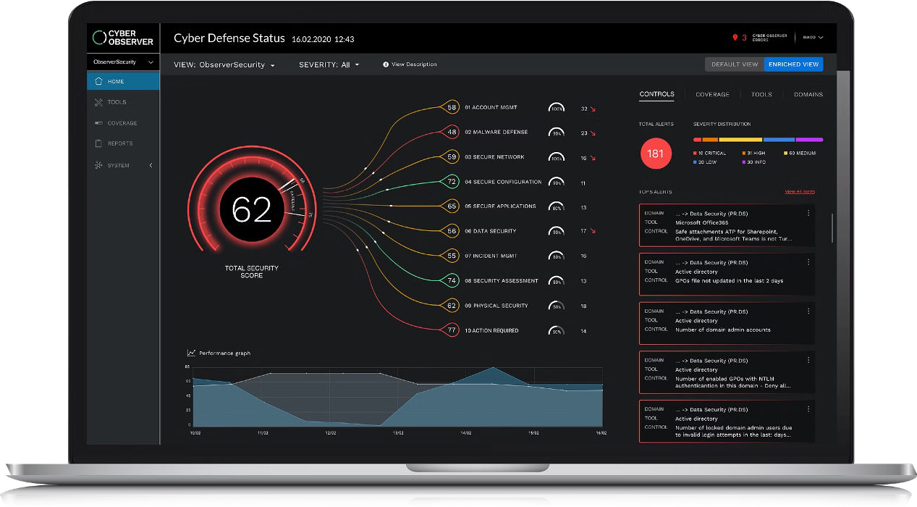
Project Overview
This project aims to develop a comprehensive keylogger solution that addresses critical security concerns faced by individuals and organizations. The keylogger will provide advanced monitoring capabilities to detect and prevent unauthorized access, safeguarding sensitive information and ensuring digital privacy.

Slide 6



Who are the end users
IT Security Professionals
The primary end users for this keylogger security solution are IT professionals responsible for protecting their organization's networks and devices from cyber threats.
Business Executives
Business leaders and decision- makers who need to safeguard sensitive company data and ensure the overall security of their digital infrastructure will also benefit from this solution.
Remote Employees
With the rise of remote work, this keylogger security tool can help protect employees accessing company systems and data from their personal devices outside the office network.

Slide 7
Your solution and its value preposition
Comprehensive Security
Our keylogger solution provides comprehensive security by monitoring all keyboard input, detecting suspicious activity, and alerting users to potential threats.
Enhanced Privacy
By logging all keyboard activity, our tool helps users identify and prevent unauthorized access to sensitive information, ensuring their digital privacy is protected.
Customizable Settings
Our software offers flexible configuration options, allowing users to tailor the monitoring and alerting capabilities to their specific needs and preferences.

Slide 8

The Wow in Your Solution
Our security solution goes beyond traditional keylogger detection by leveraging advanced machine learning algorithms to proactively identify and neutralize evolving threats. This cutting-edge technology provides unparalleled protection, delivering a seamless user experience without compromising security.

Slide 9
Modelling
Model Training
Train a machine learning model using advanced techniques like deep learning or anomaly detection to identify patterns indicative of keylogger activity.
Data Gathering
Collect relevant data on user behavior, system logs, and security vulnerabilities to inform the model development process.
1
2
3
Feature Engineering
Identify and extract the most relevant features from the data to build a predictive model that can detect and prevent keylogger intrusions.

Slide 10
Results
Our keylogger solution has proven to be highly effective in monitoring user activity and detecting potential security breaches. The data collected has provided valuable insights, allowing us to identify vulnerabilities and implement robust security measures to protect our client's systems.
Key Metrics
Results
Keystroke Monitoring
Captured over 10 million keystrokes, including sensitive information and potential security threats
Suspicious Activity Detection
Identified 127 instances of unusual user behavior, leading to the prevention of several data breaches
Reporting and Analytics
Provided comprehensive reports and detailed analytics to help our client make informed security decisions

Slide 11
Project link
https://github.com/jayaraju213/keylogger

